Slide 1

Student Details
Name : A.sree charan kumar
College : SRM university AP
STREAm : AI & ML
Internship company : EDUNET Foundation

Slide 2
PROJECT TITLE/Problem Statement
PROJECT TITLE : EMPLOYEE BURNOUT PREDICTION USING LINEAR REGRESSION
PROBLEM STATEMENT:
Employee burnout is a critical issue in modern workplaces, leading to reduced productivity, increased absenteeism, and higher turnover rates.
This project aims to Determine the key factors contributing to employee burnout by analyzing various workplace variables such as work hours, job role, stress levels, and support from management.

Slide 3
AGENDA
PROJECT TITLE/PROBLEM STATEMENT​
PROJECT OVERVIEW​
WHO ARE THE END USERS OF THIS PROJECT?​
YOUR SOLUTION AND ITS VALUE PROPOSITION​
MODELLING​
RESULTS​
​

Slide 4
PROJECT OVERVIEW
Employee burnout is a significant issue affecting productivity, job satisfaction, and overall well-being in the workplace. This project aims to develop a predictive model using linear regression to identify employees at risk of burnout, enabling organizations to take proactive measures to prevent it.
Objectives
Identify Key Factors: Determine the primary factors contributing to employee burnout by analyzing workplace variables.
Develop Predictive Model: Create a linear regression model to predict the likelihood of burnout based on the identified factors.
Provide Insights and Recommendations: Offer actionable insights and recommendations for organizations to mitigate burnout and improve employee well-being.

Slide 5
PROJECT OVERVIEW
Methodology
Data Preprocessing: Cleaning and preparing the data by handling missing values, encoding categorical variables, and normalizing the data.
Exploratory Data Analysis (EDA): Analyzing the data to uncover patterns and relationships between features.
Feature Selection: Identifying the most relevant features for the prediction model using statistical methods and domain knowledge.
Model Development: Building and training the linear regression model using the training dataset.
Model Evaluation: Assessing the model's performance using metrics such as R-squared, Root Mean Squared Error (RMSE), and Mean Absolute Error (MAE).

Slide 6
WHO ARE THE END USERS of this project?
Human Resources (HR) Managers​
Utilize the predictive model to identify employees at risk of burnout.​
Line Managers and Team Leaders​
Monitor the well-being of their team members using the model's predictions.​
Company Executives and Leadership​
Leverage insights from the model to inform strategic decisions regarding workforce management and resource allocation.​
Employee Wellness Programs​
Design and implement wellness initiatives based on the model’s insights.​
Data Analysts and Researchers​
Continuously improve the model by analyzing its performance and updating it with new data.​

Slide 7
YOUR SOLUTION AND ITS VALUE PROPOSITION
The solution involves developing a predictive model using linear regression to forecast employee burnout based on various workplace factors.
The solution involves a comprehensive analysis of employee burnout within an organization, employing both quantitative and qualitative research methods. and to develop actionable recommendations to mitigate burnout and enhance employee well-being.​
This model will provide early warnings, enabling targeted interventions and support programs to be implemented proactively. ​
The value of this solution lies in its ability to manage employee well-being effectively, increase job satisfaction, reduce turnover, and enhance organizational productivity. ​
the solution fosters continuous improvement, ensures ethical and fair practices, and builds trust among employees.​

Slide 8
How did you customize the project and make it your own
Employee-Centric Approach: Focusing on creating a solution that truly benefits employees by prioritizing their well-being and providing actionable, personalized interventions.
Continuous Learning: Staying updated with the latest research and advancements in predictive analytics and employee well-being to keep improving the project.

Slide 9
MODELLING
Data Collection and Integration​
Data Sources: Gather employee data from surveys, HR records, performance evaluations, and attendance logs.​
Data Preprocessing​
Cleaning: Handle missing values, outliers, and inconsistencies to prepare data for analysis.​
Model Development​
Utilize linear regression to predict burnout risk based on identified features.Split data into training and testing sets, train
the model on the training set, and validate its performance​
Model Evaluation​
Performance Metrics: Assess model performance using metrics like R-squared, RMSE, and MAE to ensure accuracy
and reliability.​
Model Deployment and Maintenance​
Monitoring: Continuously monitor model performance and update it with new data to maintain relevance and
effectiveness.​

Slide 10
STATISTICAL TECHNIQUES
Linear Regression Model :​
Linear Regression Formula: y=β0+β1x1+β2x2+⋯+βn xn+ϵ
​
Where:​
Y is the dependent variable.​
x1,x2,…,xn are the independent variables.​
β1,β2,…,βn are the coefficients.​
ϵ is the error term.

Slide 11
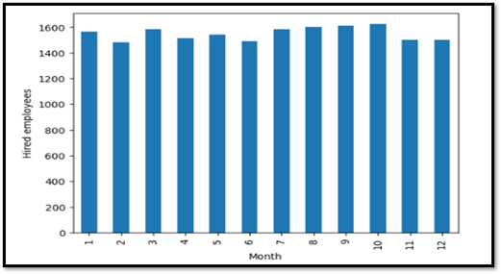
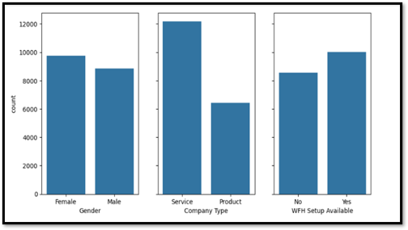
Results

Slide 12
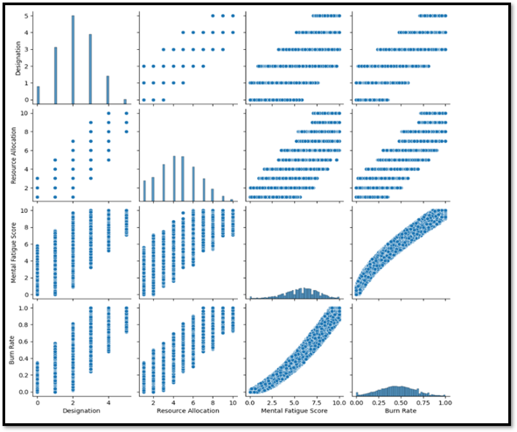
RESULTS
Linear Regression Model Performance Metrics:
​
Mean Squared Error: ​
0.0031569779113610717​
Root Mean Squared Error:​
0.0561869905882231 ​
Mean Absolute Error: ​
0.04595032032644773 ​
R-squared Score:​
0.918822674247248 ​

Slide 13
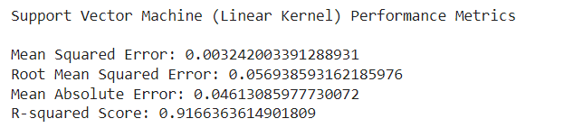
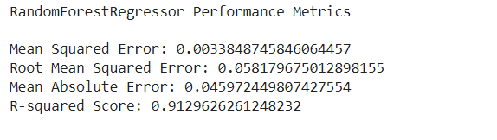
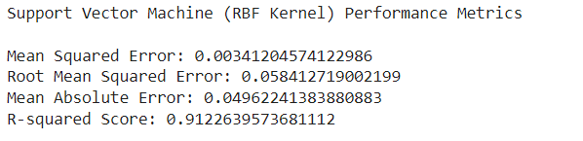
RESULTS in other methods

Slide 14
links
https://colab.research.google.com/drive/1UNcIG3pULDxXAt2_xapuhMHk8eTA2MVy?usp=sharing

